Slide 1
Weather System A Python application for General and Aviation weather Lauren Freiler

Slide 2
WeatherApp/
├── app.py
├── services/
│ ── aviation_weather.py
│ └── openweather.py
├── tests/
├── requirements.txt
├── .env
└── .gitignore

Slide 3
User input
↓
Tkinter GUI
↓
Weather service class - AviationWx /OpenWeatherService
↓
External API
↓
JSON response
↓
Formatted display

Slide 4
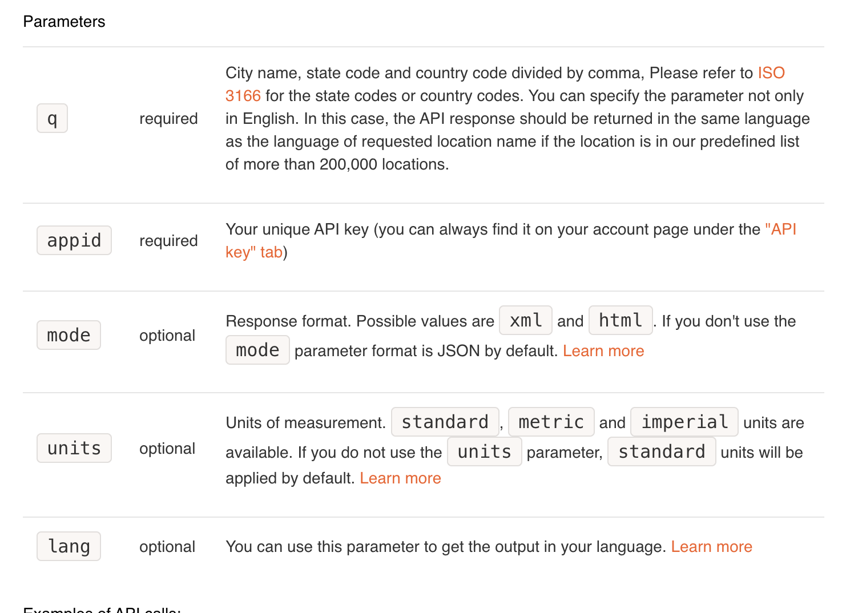
How App Retrieves Wx Data
def get_weather(self, city):
parameters = {
"q": city,
” appid": self.api_key,
"units": "imperial",
}
response = requests.get(
self.weather_url,
params=parameters,
timeout=10,
)
if response.status_code == 200:
return response.json()
This method:
-creates the query parameters
- sends an HTTP GET request
-converts from JSON to Python dictionaries/lists

Slide 5
Protecting API Key
from dotenv import load_dotenv
import os
load_dotenv()
api_key = os.getenv("WEATHER_API_KEY")
The actual key is stored in .env.
load_dotenv() makes the setting available to the program, and os.getenv() retrieves it. The .gitignore entry prevents the file containing the key from being uploaded to GitHub.

Slide 6
Displaying the Metar/Wx
def show_metar(self):
station_id = self.station_entry.get().strip().upper()
if not station_id:
messagebox.showwarning(
"Missing identifier",
"Please enter a station identifier."
)
return
data = self.aviation_weather.get_metar(station_id)
if not data:
messagebox.showerror(
"METAR unavailable",
f"No recent METAR was found for {station_id}."
)
return
#get first item in data
metar = data[0]
clouds = metar.get("clouds", [])
if clouds:
cloud_description = str(clouds[0])
else:
cloud_description = "No cloud layers reported"
result = (
f"Current METAR: {station_id}\n"
f"--------------------------------\n"
f"Airport: {metar.get('name', 'Unknown')}\n"
f"Temperature: {metar.get('temp', 'N/A')} C\n"
f"Dewpoint: {metar.get('dewp', 'N/A')} C\n"
f"Wind direction: {metar.get('wdir', 'N/A')}\n"
f"Wind speed: {metar.get('wspd', 'N/A')} knots\n"
f"Visibility: {metar.get('visib', 'N/A')} SM\n"
f"Altimeter: {metar.get('altim', 'N/A')}\n"
f"Clouds: {cloud_description}\n"
)
self.display_result(result)
Takes the weather data returned by the API and prepares it for display.
API originally sends the information as JSON, and Python converts that JSON into a combination of dictionaries and lists.
Using .get() returns N/A if data is missing

Slide 7
Data = {}
{'coord': {'lon': -122.3321, 'lat': 47.6062}, 'weather': [{'id': 500, 'main': 'Rain', 'description': 'light rain', 'icon': '10d'}], 'base': 'stations', 'main': {'temp': 60.6, 'feels_like': 60.22, 'temp_min': 58.17, 'temp_max': 63.05, 'pressure': 1023, 'humidity': 82, 'sea_level': 1023, 'grnd_level': 1013}, 'visibility': 10000, 'wind': {'speed': 5.01, 'deg': 198, 'gust': 8.99}, 'rain': {'1h': 0.25}, 'clouds': {'all': 100}, 'dt': 1785690662, 'sys': {'type': 2, 'id': 2009669, 'country': 'US', 'sunrise': 1785674890, 'sunset': 1785728573}, 'timezone': -25200, 'id': 5809844, 'name': 'Seattle', 'cod': 200}

